Slide 1
Data Encapsulation and Abstraction in java -
Encapsulation means "to put something in a capsule (a wrapper)", so that it is not directly accessible to outside world.
For example like medicine capsule, the medicine within capsule wrapper is not accessible until capsule is dipped in some liquid. I.e. to access medicine within capsule wrapper we have to follow certain procedure (rules and regulations).
In the same way Data Encapsulation means to put data (variables) in some wrapper so that it is not directly accessible to outsiders. The wrapper here will be the private access specifiers i.e. declare variables as private so that they are not accessible outside the class. This process of hiding data from outsiders is known as Data Hiding. And if any user outside the class wants to access encapsulated data then he has to follow certain rules and regulations and these rules and regulations are defined by public methods.
Abstraction means showing only essential details by hiding unnecessary details. For example when user is doing an online transaction, he does not need to know internal working of how transaction is taking place (unnecessary details for user), he is provided with an interface (essential detail) by which he can easily made his transaction.

Slide 2
public int getId()
{
return id;
}
public void setName(String n)
{
name = n;
}
public String getName()
{
return name;
}
public void setSalary(int s)
{
if(s<=0)
{
throw new RuntimeException("Salary should be greater than zero");
}
else
{
salary = s;
}
}
public int getSalary()
{
return salary;
}
}
Example -
class Employee
{
private int id;
private String name;
private int salary;
public void setId(int i)
{
if(i<=0)
{
throw new RuntimeException("ID should be greater than zero");
}
else
{
id = i;
}
}

Slide 3
public class Demo
{
public static void main(String args[])
{
Employee emp1 = new Employee();
emp1.setId(1); // Accessing data using public methods b/c data is encapsulated by making them private.
emp1.setName("Tom");
emp1.setSalary(20000);
System.out.println("Employee details :"+ emp1.getId()+" "+emp1.getName()+" " + emp1.getSalary());
}
}

Slide 4
In the above program we declare all data (id, name, salary) of the Employee class as private so that anyone outside the class should not be able to access it directly. This process of wrapping the data in private access specifier is known as Data Encapsulation. If someone wants to access this encapsulated data then he has to follow certain rules and regulations, and we have declared these rules and regulations by defining methods (for example if user enter id of employee less than one then a Runtime Exception object will be thrown showing the message 'ID should be greater than zero' and programs terminates there). Right now, you do not need to be worried about what Exception is,You will learn it later.For now just consider that it will stop program execution and show the message whatever you entered in double quotes.). The rules and regulations defined for accessing encapsulated data is known as Data Abstraction.

Slide 5
Benefit of Data Encapsulation -
So now the question arises why we encapsulate data, and what is the benefit of doing this? By making data encapsulated, we ensure that anyone outside the class should not be able to access the data, if he passes some anonymous values for data for example we know that Employee id can never be 0 or negative similarly salary can also never be zero or negative. So if user ever passes some negative values or zero for these data then he will not be able to access them and a Runtime Exception will be thrown.

Slide 6
Constructor –
Each object we created must be initialized to some value. We can do this in two ways - 1 - We can initialize objects by using dot operator -
emp1.id = 1;
emp1.name="Tom";
2 - Secondly we can initialize objects by using methods –
emp1.setId(1);
emp1.setName("Tom");
But the initialization of objects is so common that Java enables objects to initialize themselves when they are created. This automatic initialization is done through the use of Constructor. Constructors are similar to methods and have the following features - 1- They have the same name as class name. 2- They do not have any return type, not even void. 3- They run automatically as a new object is created and run only once for any object. 4- If we do not explicitly create any constructor in class than a default constructor is automatically created by Java run time system.

Slide 7
Example 1-
class Employee
{
public void a()
{
System.out.println("AAA");
}
public void b()
{
System.out.println("BBB");
}
public Employee() // Constructor
{
System.out.println("You are in Constructor");
}
}
public class Demo
{
public static void main(String args[])
{
Employee emp1 = new Employee(); // Calling constructor //
emp1.Employee(); Error we cannot call constructors like simple methods.
emp1.a();
emp1.b();
}
}

Slide 8
Program Description -
Note that constructor :
public Employee()
{
System.out.println("Constructor");
}
Have the same name as class name and also do not have any return type. As we create the object by writing the code:
Employee emp1 = new Employee();
compiler will search for a Employee() constructor in Employee class and run it automatically. That is why 'You are in Constructor' is printed first . Also note that constructor runs only once for any object when we create that object, we cannot call them multiple times like java methods.

Slide 9
Types of Java Constructor -
Constructor is of two types - 1- Constructor without parameter (Default Constructor) - If a constructor does not have any parameter than it is called Default Constructor, as constructor created in last example. If you do not define any constructor explicitly, a default constructor is automatically built by java run time system. For example –
class Employee
{
}
Even though we have not define anything within the class but compiler will automatically generate a default constructor within the class like this -public Employee()
{
}
Note - A default constructor initializes all data members (variables) of the class to their default values.

Slide 10
2 - Constructor with parameter (Parameterized Constructor) - If a constructor has one or more parameters then it is called parameterized constructor. For example –
public Employee(int i, String n)
{
//Statements;
}
Example –
class Employee
{
int id; String name;
public void input()
{
id = Integer.parseInt(System.console().readLine("Enter ID"));
name = System.console().readLine("Enter name");
}
public void disp()
{
System.out.println(id+ " " + name);
}

Slide 11
public Employee(int i, String n) // parameterized constructor
{
id = i;
name = n;
}
}
public class Demo
{
public static void main(String args[])
{
Employee emp1 = new Employee(1, "Tom");
emp1.disp();
}
}

Slide 12
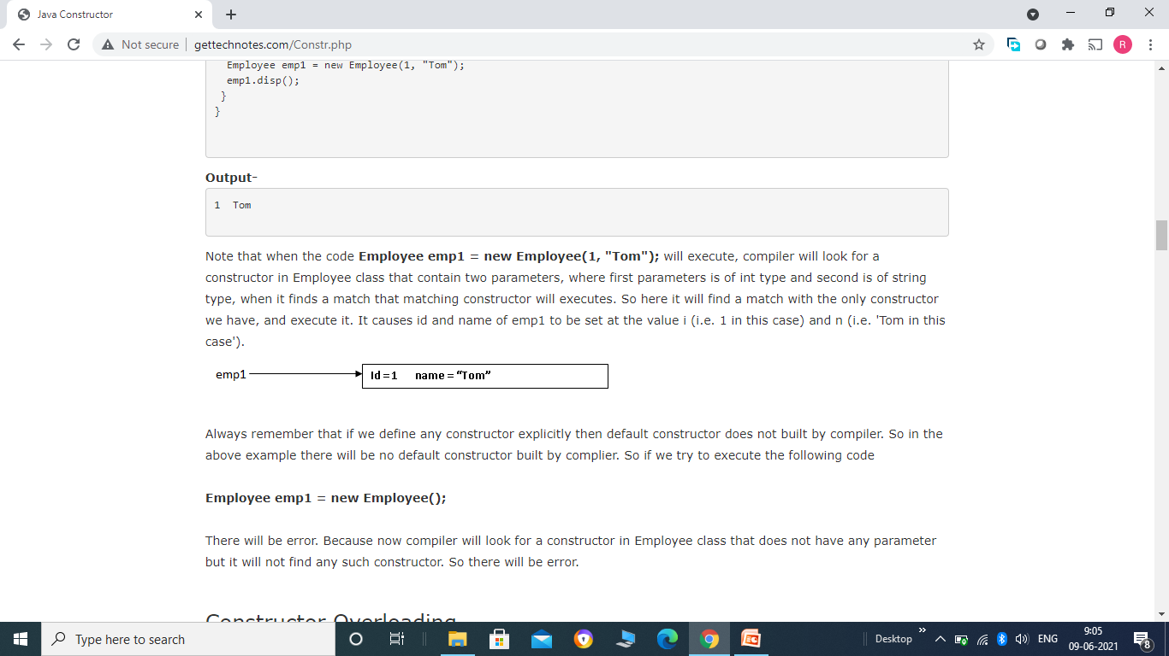
Note that when the code
Employee emp1 = new Employee(1, "Tom");
will execute, compiler will look for a constructor in Employee class that contain two parameters, where first parameters is of int type and second is of string type, when it finds a match that matching constructor will executes. So here it will find a match with the only constructor we have, and execute it. It causes id and name of emp1 to be set at the value i (i.e. 1 in this case) and n (i.e. 'Tom in this case').
Always remember that if we define any constructor explicitly then default constructor does not built by compiler. So in the above example there will be no default constructor built by complier. So if we try to execute the following code Employee emp1 = new Employee(); There will be error. Because now compiler will look for a constructor in Employee class that does not have any parameter but it will not find any such constructor. So there will be error.

Slide 13
Constructor Overloading -
If we define more than one constructor within a class then it is called constructor overloading. A class can have any number of constructor as long as their parameter declaration is different i.e. either the number of parameter or data type of parameter should be different.
Example -
class Employee
{
int id; String name;
public void input()
{
id = Integer.parseInt(System.console().readLine("Enter ID"));
name = System.console().readLine("Enter name");
}
public void disp()
{
System.out.println(id+ " " + name);
}

Slide 14
public Employee() // Constructor 1
{
}
public Employee(int i) // Constructor 2
{
id = i;
}
public Employee(String n) // Constructor 3
{
name = n;
}
public Employee(int i, String n) // Constructor 4
{
id = i;
name = n;
}
public Employee(String n, int i) // Constructor 5
{
id = i;
name = n;
}
}

Slide 15
public class Demo
{
public static void main(String args[])
{
Employee emp1 = new Employee();
Employee emp2 = new Employee(1);
Employee emp3 = new Employee("Tom");
Employee emp4 = new Employee(1, "Tom");
emp1.disp();
emp2.disp();
emp3.disp();
emp4.disp();
}
}

Slide 16
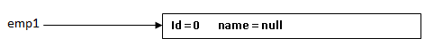
Here we have defined 5 constructors, Constructor 1 does not have any parameter, Constructor 2 has 1 parameter of int type, Constructor 3 also has 1 parameter but it is of String type, and so on. When the code Employee emp1 = new Employee(); gets executed, it will cause the compiler to look for a constructor that is not having any parameter, so Constructor 1 will gets executed and initialize data fields of emp1 to their default value (i.e. 0 for int and null for String)
Note the default value of object type is null. The next line Employee emp2 = new Employee(1); will cause the compiler to look for a constructor that is having only one parameter of int type , so Constructor 2 will gets executed and initialize id to 1 and name to null.

Slide 17
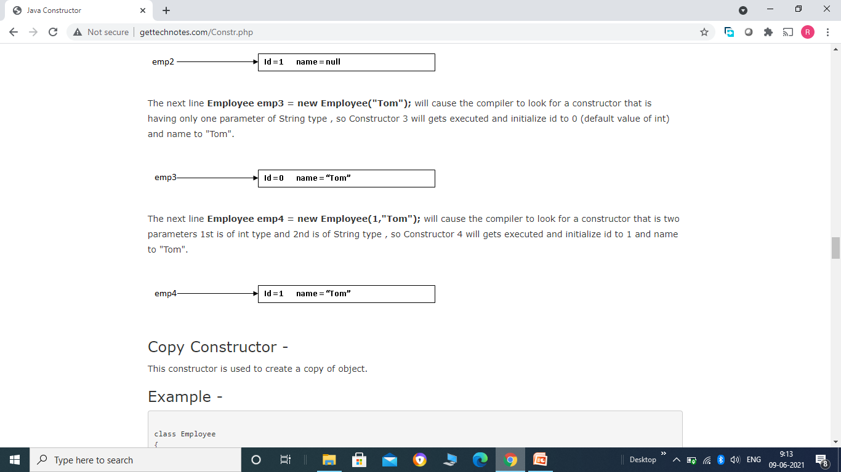

Slide 18
Copy Constructor -
This constructor is used to create a copy of object.
Example -
class Employee
{
int id; String name;
public void input()
{
id = Integer.parseInt(System.console().readLine("Enter ID"));
name = System.console().readLine("Enter name");
}
public void disp()
{
System.out.println(id+ " " + name);
}
public Employee(int i, String n)
{
id = i;
name = n;
}

Slide 19
public Employee(Employee emp) // Copy Constructor
{
id = emp.id;
name = emp.name;
}
}
public class Demo
{
public static void main(String args[])
{
Employee emp1 = new Employee(1, "Tom");
emp1.disp();
Employee emp2 = new Employee(emp1);
emp2.disp();
}
}

Slide 20
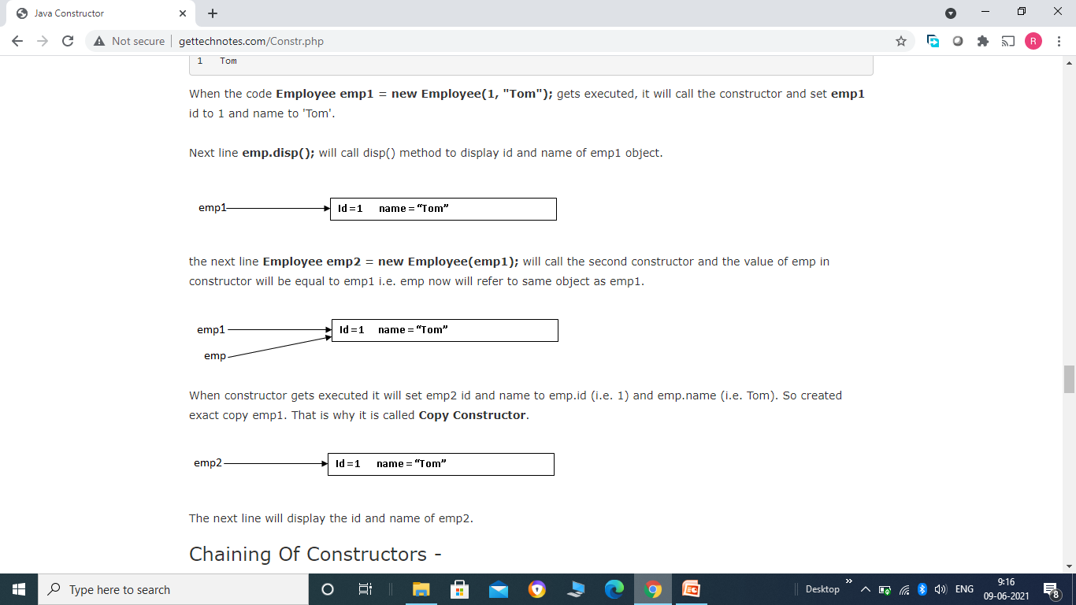

Slide 21
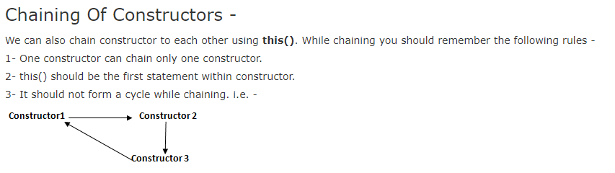
Example -
class Employee {
int id; String name;
public void input() {
id = Integer.parseInt(System.console().readLine("Enter ID"));
name = System.console().readLine("Enter name");
}
public void disp() {
System.out.println(id+ " " + name);
}

Slide 22
public Employee(int i) // Constructor 1
{
id = i;
}
public Employee(String n) // Constructor 2
{
name = n;
}
public Employee(int i, String n) // Constructor 3
{
this(i); // chaining to constructor 1
name = n;
}
public Employee(String n, int i) // Constructor 4
{
this(i,n); // chaining to constructor 3
}
public Employee(Employee emp) // Constructor 5
{
this(emp.name); // chaining to constructor 2
id = emp.id;
}
}

Slide 23
public class Demo {
public static void main(String args[]) {
Employee emp1 = new Employee("John", 2);
emp1.disp();
}
}
'this' keyword -
this means 'object of current class'. It refers to the current object. 'this' keyword is normally used to differentiate between local and class variables within a method. When local variables within method have the same name as class variables then local variables hides the class variables. In that case this keyword is used to refer class variables. For example –
consider the Constructor 4 of previous example –
public Employee(int id, String name)
{
this.id = id;
this.name = name;
}
Here this.id refers to object's id and id refers to method's id. Similarly this.name refers to object name and name refers to method name.

Slide 24
Method Overloading (Function Overloading) -
In java it is possible to have multiple methods with the same name in a class as long as their parameter declarations are different i.e. either the number of parameters or data types of parameters are different. In this case methods are said to be overloaded and process is referred as method overloading. This is one of the ways Java supports the concept of Polymorphism. When an overloaded method is called, Compiler checks for the number and data types of parameters to determine which overloaded method to call. Note - Always remember that there is no method overloading on the basis of return type of methods.

Slide 25
Example -
class Test {
public int sum(int a) // version 1
{ return (a+a);
}
public int sum(int a, int b) // version 2
{ return (a+b);
}
public double sum(double a) // version 3
{ return (a+a);
}
public double sum(double a, double b) // version 4
{ return (a+b);
}
}

Slide 26
public class Demo {
public static void main(String[] args) {
Test t1 = new Test();
int sum1 = t1.sum(1); // call to version1
int sum2 = t1.sum(1,2); // call to version2
double sum3 = t1.sum(10.5); // call to version3
double sum4 = t1.sum(11.5, 12.5); // call to version4 System.out.println(sum1+" "+sum2+" "+sum3+" "+sum4); }
}
It is clear from the above example when an object call to an overloaded method, compiler looks for a match between the values used to call the method and method parameters. But there can be case when compiler does not find exact match. In that case java automatically performs type conversion to call the method and this conversion is only possible if method parameter data type is larger in size compared to arguments (values) used to call the method. This conversion is only take place when compiler does not find exact match.

Slide 27
For Example -
class Test {
public int sum(int a, int b) // version 1
{ return (a+b);
}
public double sum(double a) // version 2
{ return (a+a);
}
}
public class Demo {
public static void main(String[] args) {
Test t1 = new Test();
int sum1 = t1.sum(1, 2); // call to version1
double sum2 = t1.sum(10); // call to version2
double sum3 = t1.sum(10.5); // call to version2
System.out.println(sum1+" "+sum2+" "+sum3);
}
}

Slide 28
Here when the code double sum2 = t1.sum(10); gets executed compiler will look for the version of sum that contain one parameter of int type, but there is no such sum method, So automatic type conversion take place and int value gets converted into double and version2 of sum gets call and return the result in sum2 variable.

